Slide 1

Notes:
1st slide (Mandatory)

Slide 2
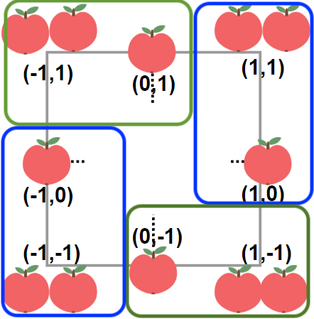

Alice Apple Tree
Assume the vertex is (r,r),(r,-r),(-r,r) and (-r,-r). Split the apples into 4 rectangles, each rectangle is r * (r + 1).
Put two blue matrix together and merge apples tiles at the same position, each tile become r + r + 1. The total apples in blue is, r * (r + 1) * (r + r + 1)
Put two green matrix together and merge apples tiles at the same position, each tile become r + r + 1. The total apples in green is, r * (r + 1) * (r + r + 1)
The total apples is: r * r * r * 4 + r * r * 6 + r * 2.
Then we apply binary search.

Slide 3
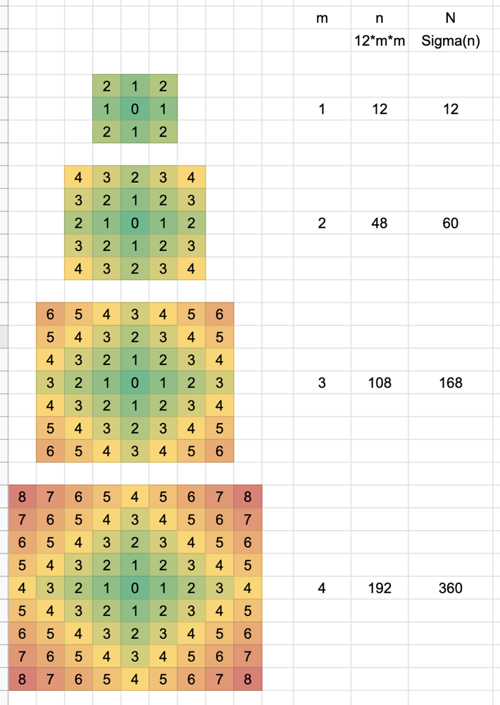

Slide 4
import java.util.*;
public class AliceAppleTree {
public static void main(String[] args) {
Scanner sc=new Scanner(System.in);
int apple=sc.nextInt();
int cnt=0,sum=0;
while(sum<apple){
cnt++;
sum+=(12*cnt*cnt);
}
System.out.println((8*(cnt)));
}
}

Slide 5
Toggle The Switch
Problem statement
There are 100 closed doors. A cage holding 100 monkeys is placed nearby. Every monkey that visits a door either opens a closed door or closes an open door. The first monkey that is let out of the cage visits and opens all the hundred doors. The second monkey that is released visits doors of the order 2, 4, 6, 8, 10…. . The third monkey released visits doors 3, 6, 9,12, 15……, and so on.
After all the monkeys from the cage are released and have opened or closed at least one door, how many doors are left open?
Approach
Let us understand how to solve this problem by observing the activity of doors 13, 50, and 16. 13 is a prime number, 50 is a composite number, and 16 is a perfect square.

Slide 6
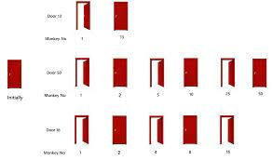

Slide 7
import java.util.*;
public class Toggle {
public static void main(String[] args) {
Scanner sc = new Scanner(System.in);
int n = sc.nextInt();
boolean b[]= new boolean[n+1];
int i,j,c=0,o=0;
for(i=1;i<=n;i++)
{
for(j=i;j*i<=n;j++)
{
if(b[j]==false)
{
b[j]=true;
}
else{
b[j]=false;
}
}
}
for(i=1;i<=n;i++)
{
if(b[i]==true)
{
c++;
}
else{
o++;
}
}
System.out.println("No Of Doors open"+c);
System.out.println("No Of Doors closed"+o);
}
}

Slide 8

THANK YOU

